Slide 1
“Turkey’s Energy Profile”
IDIS Conference Hall
June 13, 2018
A Presentation by
Dimitris Mezartasoglou
Head of Research, ΙΕΝΕ
INSTITUTE OF ENERGY
FOR SOUTH EAST EUROPE

Slide 2
Contents
Country Profile of Turkey
Turkey’s Economy
Turkey’s 2016 Energy Supply and Demand
Primary Energy Mix in Turkey (2014, 2015 and 2016)
Trend of Total Installed Electricity Capacity and Electricity Demand in Turkey over 2005-2016
Total Installed RES Capacity in Turkey (2016)
Breakdown of 2016 Electricity Generation in Turkey
Turkey’s 2016 Energy Balance
Energy Security in Turkey
Turkey’s Energy Strategy Towards 2023
Energy Exchange Istanbul (EXIST)
Turkey’s Oil and Gas Infrastructure
An Expanded Southern Gas Corridor
LNG Terminals in SE Europe
Discussion

Slide 3
Country Profile of Turkey
2016 Country Information
Capital | Ankara
Official language | Turkish
Government | Parliamentary Republic
President | Recep Tayyip Erdogan
Prime Minister | Binali Yildirim
Area | 783,562 km2
Population | 79,463,663
GDP (current prices) | $863.390 billion
GDP per capita (current prices) | $10,817
Inflation (average consumer prices) | 7.78%
Unemployment rate | 10.9%
Source: IMF World Economic Outlook Database, April 2018

Slide 4
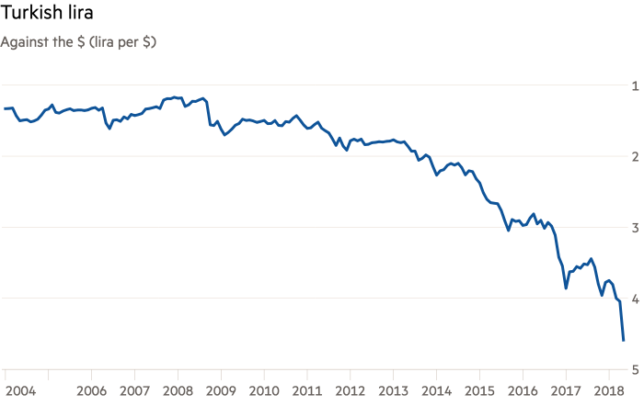
Turkey’s Economy
Sources: Thomson Reuters Datastream, Financial Times

Slide 5
Turkey’s 2016 Energy Supply and Demand (TPES=134.6 Mtoe)
Source: IEA

Slide 6
Primary Energy Mix in Turkey
2014
2016
Source: EMRA

Slide 7
Trend of Total Installed Electricity Capacity and Electricity Demand in Turkey over 2005-2016
Source: Turkish Statistical Institute (Turkstat)

Slide 8
Total Installed Electricity Capacity in Turkey (2016=78.5 GW)
Source: IEA

Slide 9
Total Installed RES Capacity in Turkey (2016=34,458 MW)
Sources: IRENA, IENE

Slide 10
Breakdown of Electricity Generation in Turkey (2016=273.4 TWh)
Source: IEA

Slide 11
Turkey’s 2016 Energy Balance

Slide 12
Energy Security in Turkey
Source: IEA

Slide 13
Turkey’s Energy Strategy Towards 2023
Turkey’s ambitious vision for 2023, the centennial foundation of the Republic, envisages grandiose targets for the country’s energy sector. Some of these targets include:
Raising the total installed power capacity to 120 GW (2016: 78.5 GW)
Increasing the share of RES to 30% in the country’s electricity mix (2016: 16%)
Maximising the use of hydro: 100% utilization target (~40-45 GW) (2016: 26.7 GW)
Increasing the installed capacity based on wind power to 20,000 MW (2016: 5.7 GW)
Installing power plants that will provide 1,000 MW of geothermal (2016: 820.9 MW) and 5,000 MW of solar energy (2016: 832.5 MW)
Extending the use of smart grids
Raising the annual gas storage capacity to more than 5 bcm (2017: 4 bcm/y)
Introducing nuclear energy into the energy mix (Akkuyu – under construction since April 2018, Sinop – under development)
Increasing the coal-fired installed capacity to 30 GW (2016: 17.3 GW)
Reducing energy intensity by 20% below 2010 levels (2016: 73 Mtoe/$PPPmn)

Slide 14
Energy Exchange Istanbul (EXIST)
Established in March 2015
Electricity market operations:
Day-ahead market
Intra-day market
Balancing market
Market registration process
Market settlement
Natural gas market:
Market operation started in April 2018: The first week of pilot online gas trading system was between April 1 and 7, 2018

Slide 15
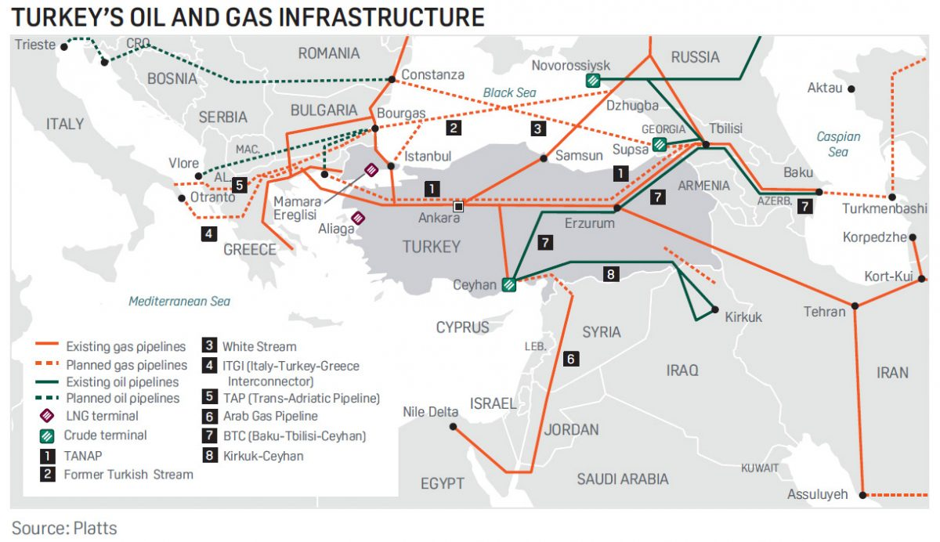
Turkey’s Oil and Gas Infrastructure
Source: Platts

Slide 16
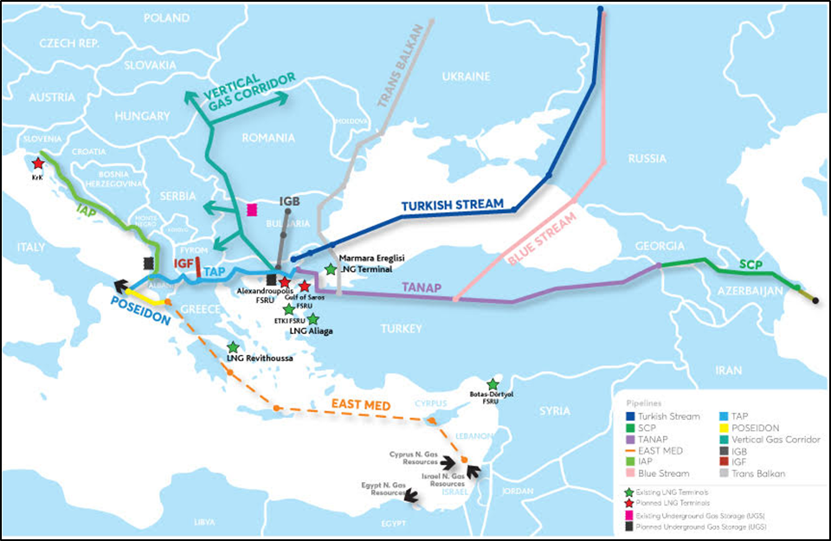
An Expanded Southern Gas Corridor
NB.: The TANAP and TAP gas pipelines as well as Turkish Stream are under construction, with IGB at an advanced planning stage with FID already taken. The IAP, the IGI Poseidon in connection with East Med pipeline and the Vertical Corridor and the IGF are still in the study phase. Blue Stream and Trans Balkan are existing pipelines.
Source: IENE

Slide 17
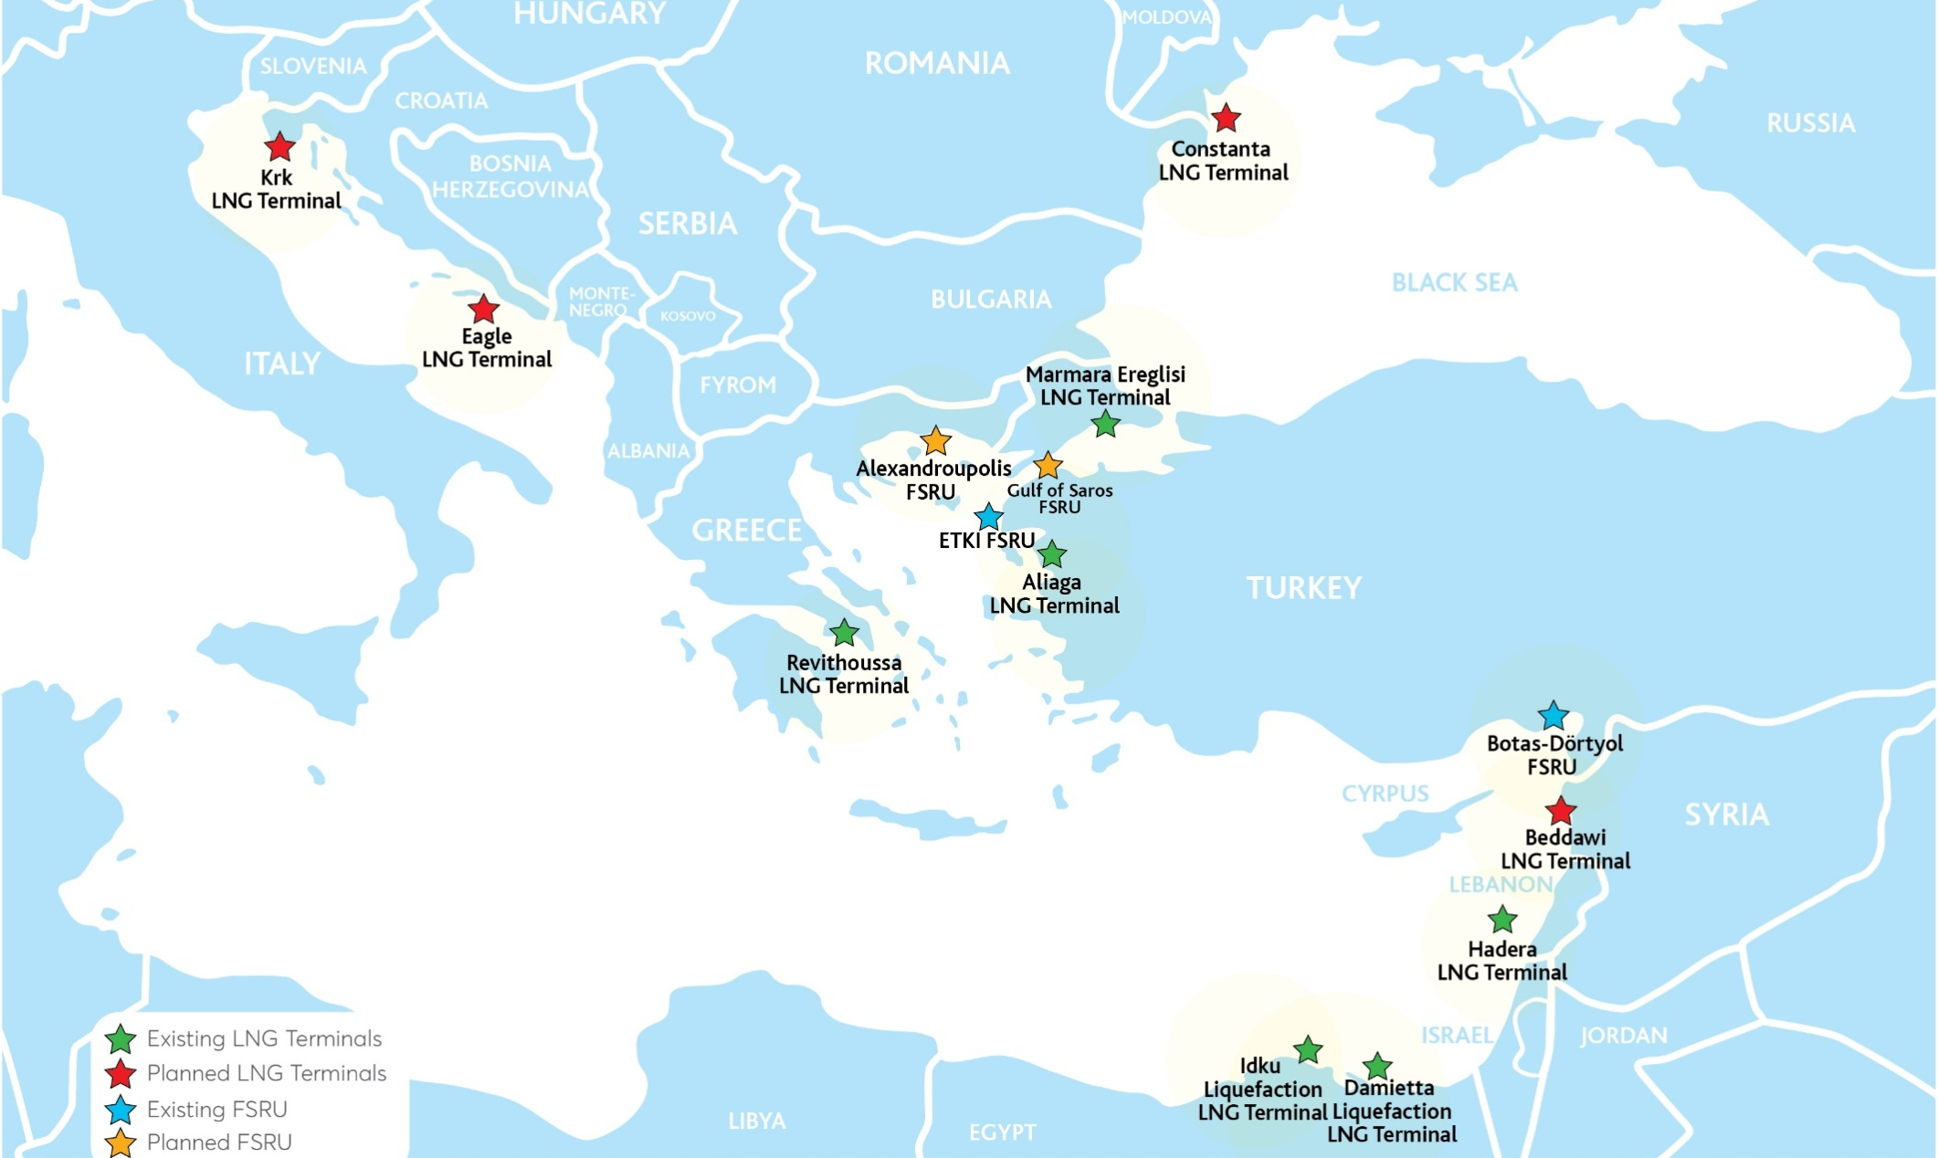
LNG Terminals in SE Europe
Source: IENE

Slide 18
Discussion
Turkey plays an important role as a “transit country” and a “regional energy hub”, one of the most unique in the world.
Among others, Turkey’s ambitious energy strategy towards 2023 includes the:
Introduction of nuclear energy into the energy mix
Maximization of the electricity produced by gas- and coal-fired power plants
Higher utilization of RES
Increase of energy storage capacities
Diversification of energy supplying countries
With diversified gas resources, underground storage capacities, LNG and FSRU terminals and functioning gas market, Turkey can substantially contribute to its energy security.
The strengthening of Turkey's energy system creates risks for Greece’s energy security.

Slide 20
Thank you for
your attention
www.iene.eu

